Slide 1

Smart Parking Analysis & Prediction System
MVP Presentation
Eylül Özdemir
Kemal Özkan

Slide 2
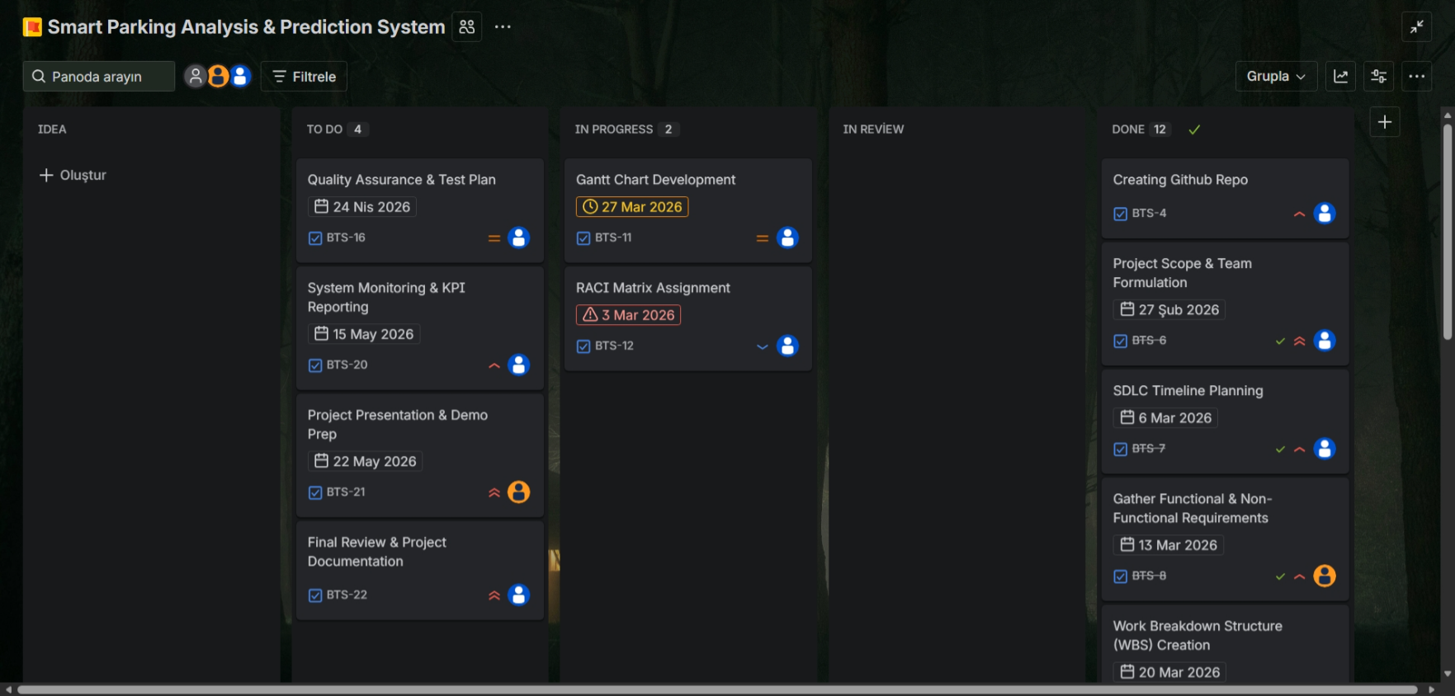
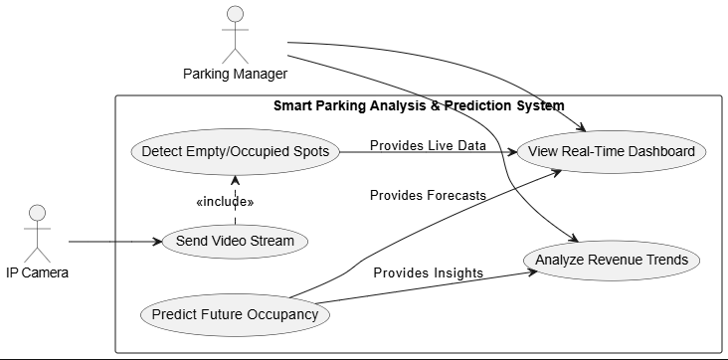
Project Management & Architecture
Strategic Planning: Defined a 14-week timeline, strict budget, and member roles inside our master Excel document.
Agile Execution: Transitioned to GitHub Projects to track active Sprints using a professional Kanban board framework.
System Blueprint: Designed system logic and data flow using detailed UML diagrams via draw.io.

Slide 3
YOLOv8 AI Core & Tech Stack
99%
mAP50 Accuracy
High-Performance Computer Vision
We processed the PKLot dataset, converting COCO JSON annotations into the streamlined YOLO format for training.
The custom-trained YOLOv8 Nano model acts as our core inference engine. It is integrated into a FastAPI backend and served to end-users via a real-time Streamlit dashboard with minimal latency.

Slide 4







Risk, Security & DevOps
Automated CI/CD
Data Privacy
Risk Downgraded
Configured GitHub Actions pipelines to automatically run syntax validation and structural integrity tests on every single code push, ensuring repository stability.
The system only processes geometric coordinates of bounding boxes. No sensitive personal data or raw video footage is permanently stored in our databases.
Following our successful training phase yielding 99% accuracy, the primary Detection Accuracy Risk has been officially updated from 'High' to 'Low'.

Slide 5
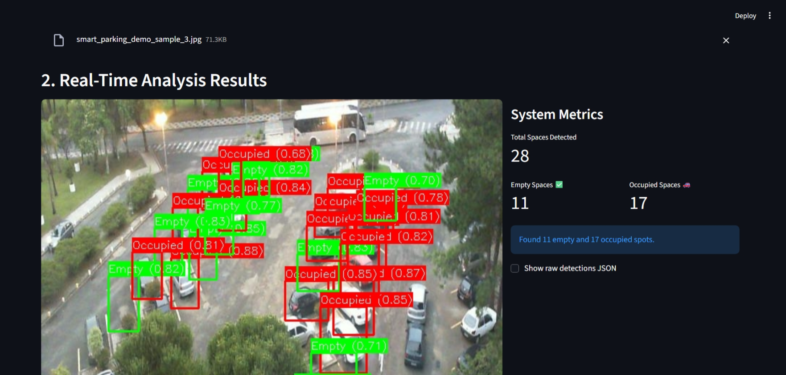
MVP Demo
Our core MVP is fully operational. The AI instantly detects empty and occupied spots from fixed-angle camera feeds with minimal latency.
For the final phase following the midterm, we will shift focus to integrate the centralized database and deploy the predictive data mining module.

Slide 6
That is All For Today
Thank you for your attention!

